Slide 1
Song Mood Analysis
By: Devin Monsen, Andi Cameron, Zach Ellsworth, and Jamee Jenkins

Slide 2
Purpose
As connoisseurs of the music industry, we recognize the vast range of emotional releases that music can induce. The purpose of this study is to examine the language of music and attempt to anticipate the effects on a listener.

Slide 3
Questions to Answer
How can rhythm, loudness, or other attributes of a song prompt an emotional response?
Which attributes are most important in determining the emotional resonance of a song?
Is there a pattern of attributes that could affect individuals similarly?

Slide 4
Data and Technologies
Source Data
Data Storage
Data Analysis
Kaggle: Spotify 1.2M+ Songs with track features obtained through the Spotify API
GitHub
Jupyter Notebook
Python
Database Management
Visualizations
postgreSQL
Python,
VSCode,
SQL Alchemy
Quick DBD for EDR Development
Google Slides

Slide 5
Data Exploration
Drop unneeded data
Create mockup dataset
Create dataframes based off mood table

Slide 6
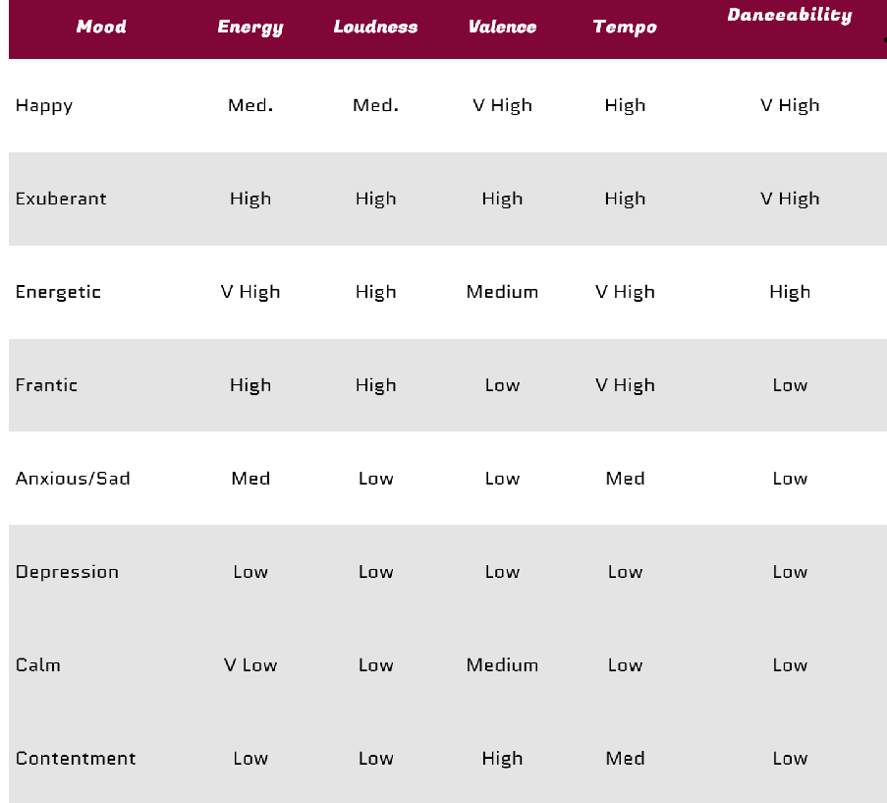
What we looked at

Slide 7
Results

Slide 8
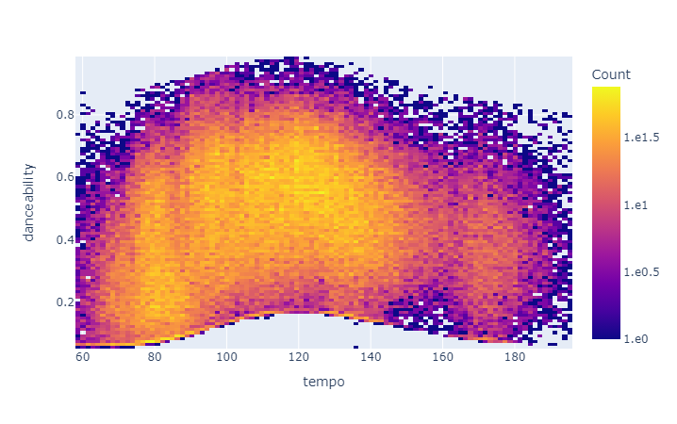
Danceability

Slide 9
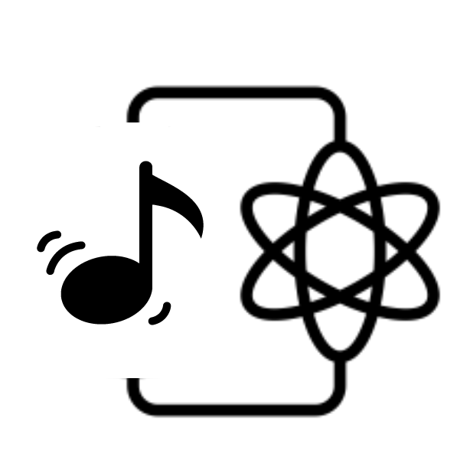

Slide 10
Questions?

